Slide 1
BT2101 Tutorial 1

Slide 2

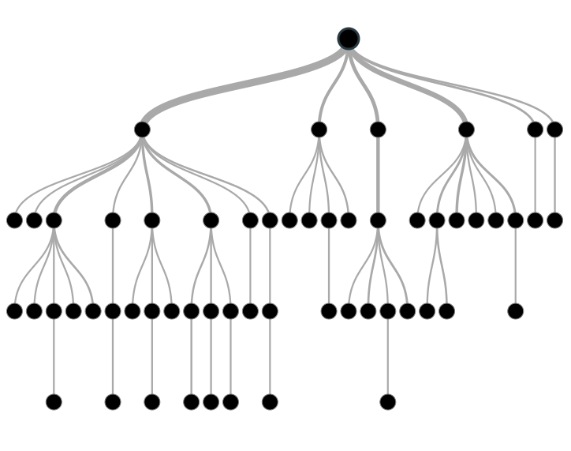

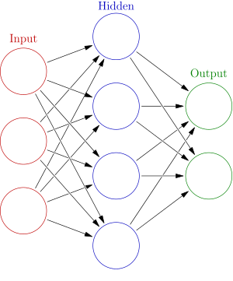
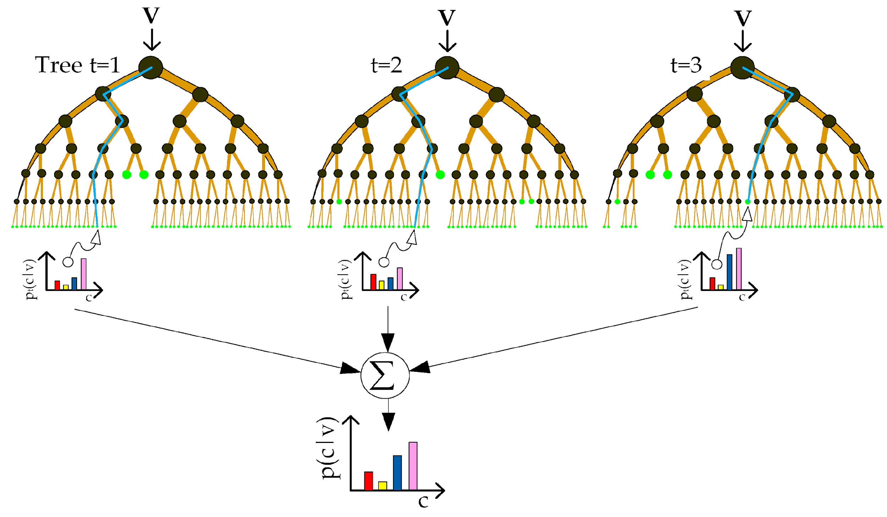
Purpose of Tutorial
Time Series
Decision Tree
Ensemble Learning
Neural Networks

Slide 3
Agenda
Form a team of 3-4
Discussion about Assignment 1
Decision Tree Split
Python Implementation
Notes:
5 min

Slide 4
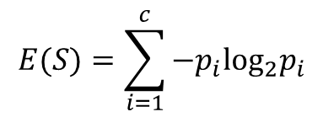

CART
Think about
Decision Tree Building
Entropy = 0 / Entropy =1 ?
Why is information gain a good tool to choose best attribute? What is the intuition behind?
What kind of features would you like to collect?
Notes:
Draw backs: attributes should categorical
should be independent example: gender and passenger class. For example, the older people have more money, so they are more likely to buy the first class ticker.
because information gain can reflect how much the attributes provide information. can reduce the uncertainty of the information

Slide 5
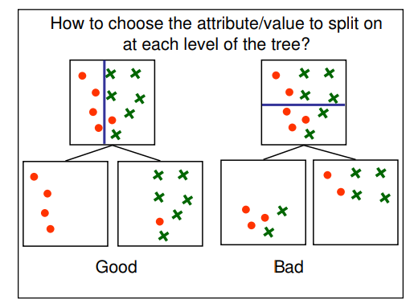
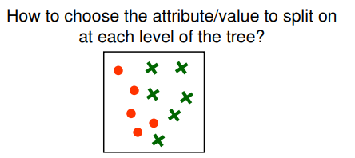
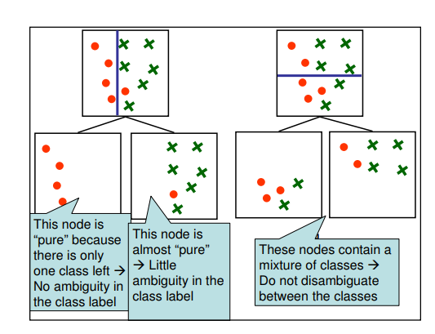
“Bad” root attribute

Slide 6
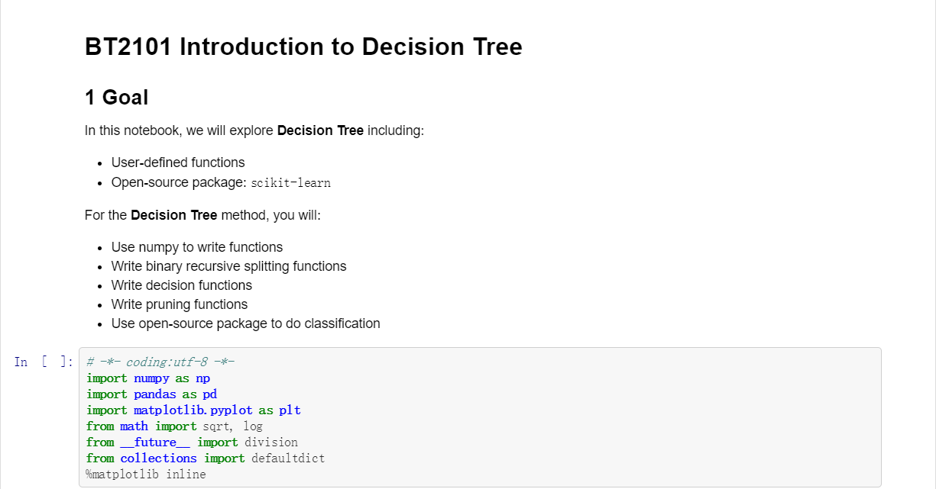
Implementation in Python
Notes:
10 min

Slide 7
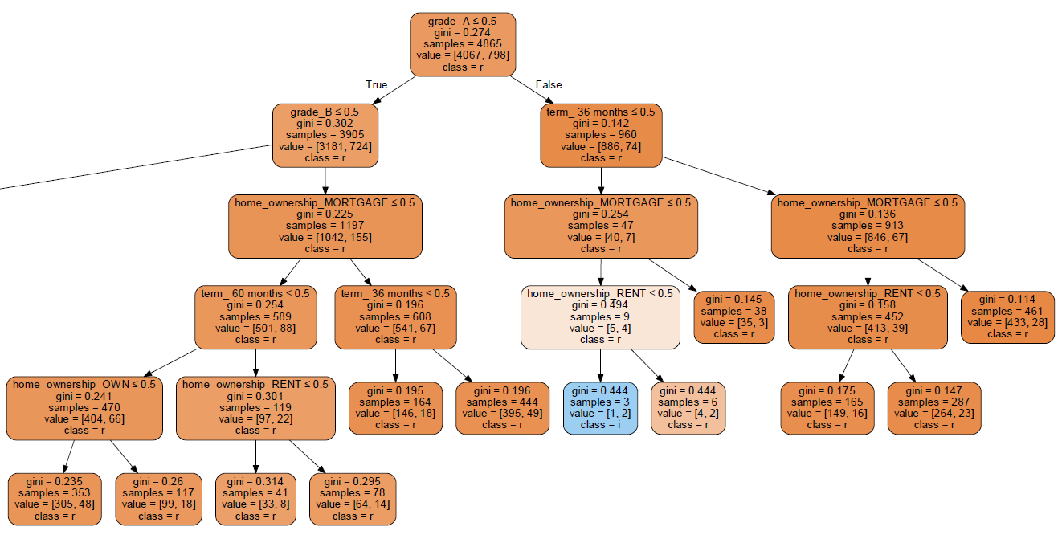
Implementation in Python
Notes:
10 min

Slide 8
Programming Assignment 1
Using the BT2101 Tutorial 1 Programming code (Decision Tree_Update.ipynb), please answer the questions in the jupyter notebook
1. Set your own stopping conditions for pre-pruning; 2. Try to do post-pruning;
3. Write a function to calculate misclassification error rate
4. Write a function to calculate gini index
5.1 What if features are continuous? Explain in words what would happen
5.2 What if output is continuous? Explain in words what happen
Answer all in the jupyter notebook.
Notes:
10 min

Slide 9
Instructions
Submit Python Notebook to IVLE HW1 Named: AXXXX_T1_program.ipynb
Include your answers in the jupyter notebook
You need to show outputs, instead of just showing functions.
Submit a DRAFT by Aug 28 before Tutorial 1 (by midnight)
Submit a FINAL program by Sept 1 (by midnight)
Based on Decision Tree_Update.ipynb

Slide 10
Thank you!

